Slide 1
Mechanics – Lecture 2
§1-1 Position vector of a particle
Wednesday 12th January 2021
Teacher: Paul Briard
Wechat: Paulbg123

Slide 2
§1-1 Position vector of a particle
What is a particle, in our case of study ?
A particle is a point-like body, with a mass associated

Slide 3
§1-1 Position vector of a particle
What is a particle, in our case of study ?
A particle is a point-like body, with a mass associated
This correspond to an ideal model (there is no body which is really a point, any bodies have a certain size)

Slide 4
§1-1 Position vector of a particle
What is a particle, in our case of study ?
A particle is a point-like body, with a mass associated
This correspond to an ideal model (there is no body which is really a point, any bodies have a certain size)
To consider particles permits to simplify the description of motion (the purpose of classical mechanics), and we will see later how this description can be extended to real bodies.

Slide 5
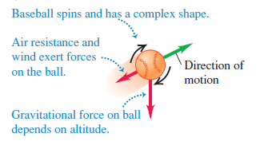
§1-1 Position vector of a particle
What is a particle, in our case of study ?
A particle is a point-like body, with a mass associated
Example:
Complicated !

Slide 6
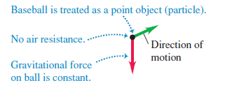
§1-1 Position vector of a particle
What is a particle, in our case of study ?
A particle is a point-like body, with a mass associated
Example:
Complicated !
More easy to describe!

Slide 7
Reference frame
To describe the motion of any bodies, it is necessary to choose a reference frame.
A reference frame is a coordinate system associated (description of the position) with a clockwork (description of the time)

Slide 8
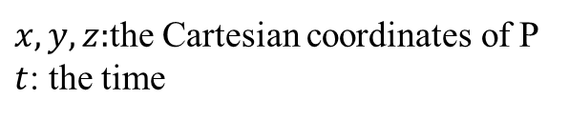






Reference frame
To describe the motion of any bodies, it is necessary to choose a reference frame.
A reference frame is a coordinate system associated (description of the position) with a clockwork (description of the time)
$$y$$
Example with a Cartesian system:
$$+P$$
$O$:Origin of the reference frame
$$O$$
$$x$$
$$z$$
$x,y,z:$the Cartesian coordinates of P
$t$: the time

Slide 9
Reference frame
To describe the motion of any bodies, it is necessary to choose a reference frame.
A reference frame is a coordinate system associated (description of the position) with a clockwork (description of the time)
$$y$$
Example with a Cartesian system:
$$+P$$
$O$:Origin of the reference frame
Trajectory of the particle (point P) in this reference frame
$$O$$
$$x$$
$$z$$
$x,y,z:$the Cartesian coordinates of P
$t$: the time
Notes:
And here you can see an example of a trajectory of the point P in this reference frame. The trajectory is the path drawn by the point P in motion. So this point P can be the particle we want to describe the motion.

Slide 10







The position vector $\vec{r}$
$$y$$
$$+P$$
$$\vec{r}$$
$$O$$
$$x$$
$$z$$
$\vec{r}$ describes the position of P in respect to the origin O of the coordinate system.

Slide 11

The position vector $\vec{r}$
$$y$$
$$+P$$
$$\vec{r}=\vec{OP}$$
$$\vec{r}$$
$$O$$
$$x$$
$$z$$

Slide 12
The position vector $\vec{r}$
$$y$$
$$+P$$
$$\vec{r}=\vec{OP}$$
$$\vec{r}$$
$$O$$
$$x$$
$$z$$
$\vec{r}$ describes the position of P in respect to the origin O of the coordinate system.

Slide 13



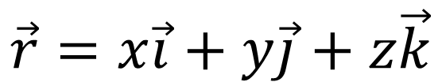
The position vector $\vec{r}$
$$y$$
$$+P$$
$$\vec{r}=\vec{OP}$$
$$\vec{r}$$
$$\vec{j}$$
$$O$$
$$x$$
$$\vec{i}$$
$$\vec{k}$$
$$z$$
$\vec{r}$ describes the position of P in respect to the origin O of the coordinate system.
$$\vec{r}=x\vec{i}+y\vec{j}+z\vec{k}$$

Slide 14





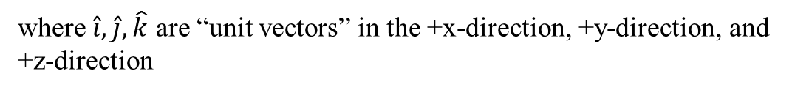

The position vector $\vec{r}$
$$y$$
$$+P$$
$$\vec{r}=\vec{OP}$$
$$\vec{r}$$
$$\hat{j}$$
$$O$$
$$x$$
$$\hat{i}$$
$$\hat{k}$$
“” means “unit vector”
$$z$$
$\vec{r}$ describes the position of P in respect to the origin O of the coordinate system.
$$\vec{r}=x\hat{i}+y\hat{j}+z\hat{k}$$
where $\hat{i},\hat{j},\hat{k}$ are “unit vectors” in the +x-direction, +y-direction, and +z-direction
$$\left|\hat{i}\right|=\left|\hat{j}\right|=\left|\hat{k}\right|=1$$

Slide 15

The position vector $\vec{r}$
$$y$$
$$+P$$
$$\vec{r}=\vec{OP}$$
$$\vec{r}$$
$$\hat{j}$$
$$O$$
$$x$$
$$\hat{i}$$
$$\hat{k}$$
$$z$$
$$\vec{r}=x\hat{i}+y\hat{j}+z\hat{k}$$

Slide 16

The position vector $\vec{r}$
$$y$$
$$+P$$
$$\vec{r}=\vec{OP}$$
$$\vec{r}$$
$$\hat{j}$$
$$O$$
$$x$$
$$\hat{i}$$
$$\hat{k}$$
$$z$$
$$\vec{r}=x\hat{i}+y\hat{j}+z\hat{k}$$
$$r^{2}=x^{2}+y^{2}+z^{2}$$

Slide 17
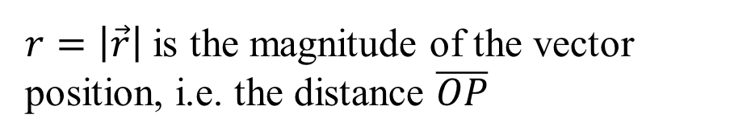
The position vector $\vec{r}$
$$y$$
$$+P$$
$$\vec{r}=\vec{OP}$$
$$\vec{r}$$
$$\hat{j}$$
$$O$$
$$x$$
$$\hat{i}$$
$$\hat{k}$$
$$z$$
$$\vec{r}=x\hat{i}+y\hat{j}+z\hat{k}$$
$$r^{2}=x^{2}+y^{2}+z^{2}$$
$r=\left|\vec{r}\right|$ is the magnitude of the vector position, i.e. the distance $\overline{OP}$

Slide 18


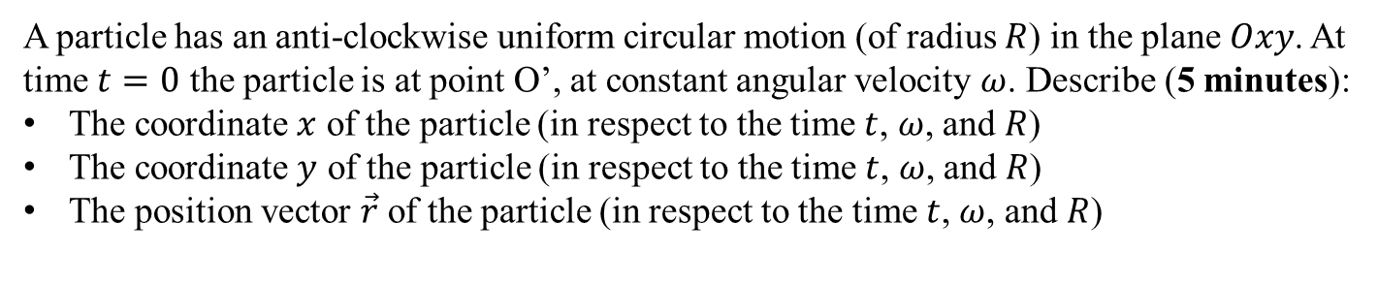






Ex. Particle in uniform circular motion
$$y$$
$$ω$$
$$P$$
$$\vec{r}$$
$$R$$
$$θ=ωt$$
$$x$$
$$O$$
O’
A particle has an anti-clockwise uniform circular motion (of radius $R$) in the plane $Oxy$. At time $t=0$ the particle is at point O’, at constant angular velocity $ω$. Describe (5 minutes):
The coordinate $x$ of the particle (in respect to the time $t$, $ω$, and $R$)
The coordinate $y$ of the particle (in respect to the time $t$, $ω$, and $R$)
The position vector $\vec{r}$ of the particle (in respect to the time $t$, $ω$, and $R$)
What is the particular property of $r$ in this situation ?

Slide 19







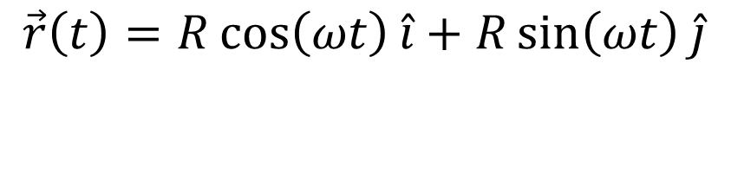

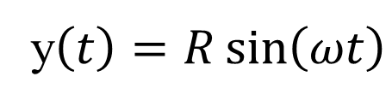


Ex. Particle in uniform circular motion
$$y$$
$$ω$$
$$x\left(t\right)=R\cos\left(ωt\right)$$
$$P$$
$$\vec{r}$$
y$\left(t\right)=R\sin\left(ωt\right)$
$$R$$
$$\hat{j}$$
$$θ=ωt$$
$$x$$
$$\vec{r}\left(t\right)=R\cos\left(ωt\right)\hat{i}+R\sin\left(ωt\right)\hat{j}$$
$$\hat{i}$$
O’

Slide 20
Ex. Particle in uniform circular motion
$$y$$
$$ω$$
$$x\left(t\right)=R\cos\left(ωt\right)$$
$$P$$
$$\vec{r}$$
y$\left(t\right)=R\sin\left(ωt\right)$
$$R$$
$$\hat{j}$$
$$θ=ωt$$
$$x$$
$$\hat{i}$$
O’

Slide 21
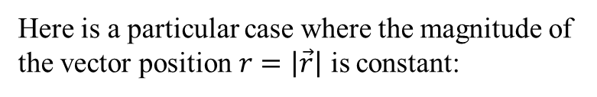
Ex. Particle in uniform circular motion
$$y$$
$$ω$$
$$x\left(t\right)=R\cos\left(ωt\right)$$
$$P$$
$$\vec{r}$$
y$\left(t\right)=R\sin\left(ωt\right)$
$$R$$
$$\hat{j}$$
$$θ=ωt$$
$$x$$
$$\vec{r}\left(t\right)=R\cos\left(ωt\right)\hat{i}+R\sin\left(ωt\right)\hat{j}$$
$$\hat{i}$$
O’
Here is a particular case where the magnitude of the vector position $r=\left|\vec{r}\right|$ is constant:

Slide 22


Ex. Particle in uniform circular motion
$$y$$
$$ω$$
$$x\left(t\right)=R\cos\left(ωt\right)$$
$$P$$
$$\vec{r}$$
y$\left(t\right)=R\sin\left(ωt\right)$
$$R$$
$$\hat{j}$$
$$θ=ωt$$
$$x$$
$$\vec{r}\left(t\right)=R\cos\left(ωt\right)\hat{i}+R\sin\left(ωt\right)\hat{j}$$
$$\hat{i}$$
O’
Here is a particular case where the magnitude of the vector position $r=\left|\vec{r}\right|$ is constant:
$$r=\sqrt{{x(t)}^{2}+{y(t)}^{2}}$$
$$r=\sqrt{R^{2}\left(\cos^{2}\left(ωt\right)+\sin^{2}\left(ωt\right)\right)}$$

Slide 23


Ex. Particle in uniform circular motion
$$y$$
$$ω$$
$$x\left(t\right)=R\cos\left(ωt\right)$$
$$P$$
$$\vec{r}$$
y$\left(t\right)=R\sin\left(ωt\right)$
$$R$$
$$\hat{j}$$
$$θ=ωt$$
$$x$$
$$\vec{r}\left(t\right)=R\cos\left(ωt\right)\hat{i}+R\sin\left(ωt\right)\hat{j}$$
$$\hat{i}$$
O’
Here is a particular case where the magnitude of the vector position $r=\left|\vec{r}\right|$ is constant:
$$r=\sqrt{{x(t)}^{2}+{y(t)}^{2}}$$
$$r=\sqrt{R^{2}\left(\cos^{2}\left(ωt\right)+\sin^{2}\left(ωt\right)\right)}$$
$$r=R$$
($r$ and $R$ are real and positive numbers)

Slide 24
§1-2- Displacement, velocity, acceleration

Slide 25












Displacement: Introduction
P(t) means “position of point P at time t”
$$+$$
$$P(t_{1})$$
$$+$$
$$P(t)$$
$$P(t_{2})$$
$$+$$
$$O$$
$$x$$
$$x=0$$
$$x_{1}$$
$$x_{2}$$
P is a point of head of the driver which moves to the right, from $x_{1}=x(t_{1})$ to $x_{2}=x(t_{2})$.

Slide 26

Displacement: Introduction
P(t) means “position of point P at time t”
$$+$$
$$P(t_{1})$$
$$+$$
$$P(t)$$
$$P(t_{2})$$
$$+$$
$$O$$
$$x$$
$$x=0$$
$$x_{1}$$
$$x_{2}$$
P is a point of head of the driver which moves to the right, from $x_{1}=x(t_{1})$ to $x_{2}=x(t_{2})$.
The displacement of point P between times $t_{1}$ and $t_{2}$ is:
$$∆x=x_{2}−x_{1}$$

Slide 27





Displacement: Introduction
$$P(t)$$
$$P(t+dt)$$
$$+$$
$$+$$
$$O$$
$$x$$
$$x=0$$
$$x(t)$$
$$x\left(t+dt\right)$$
The infinitesimal displacement of point P between times $t$ and $t+dt$ is:

Slide 28


Displacement: Introduction
$$P(t)$$
$$P(t+dt)$$
$$+$$
$$+$$
$$O$$
$$x$$
$$x=0$$
$$x(t)$$
$$x\left(t+dt\right)$$
The infinitesimal displacement of point P between times $t$ and $t+dt$ is:
$$dx=x(t+dt)−x(t)$$
where $dt$is an infinitesimal increment of time

Slide 29
Velocity: Introduction
$$+$$
$$P(t_{1})$$
$$+$$
$$P(t)$$
$$P(t_{2})$$
$$+$$
$$O$$
$$x$$
$$x=0$$
$$x_{1}$$
$$x_{2}$$
P is a point of head of the driver which moves to the right, from $x_{1}=x(t_{1})$ to $x_{2}=x(t_{2})$.

Slide 30
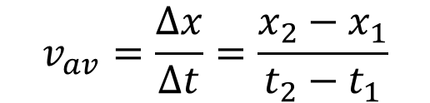
Velocity: Introduction
$$+$$
$$P(t_{1})$$
$$+$$
$$P(t)$$
$$P(t_{2})$$
$$+$$
$$O$$
$$x$$
$$x=0$$
$$x_{1}$$
$$x_{2}$$
P is a point of head of the driver which moves to the right, from $x_{1}=x(t_{1})$ to $x_{2}=x(t_{2})$.
The average velocity of point P between times $t_{1}$ and $t_{2}$ is:
$$v_{av}=\frac{∆x}{∆t}=\frac{x_{2}−x_{1}}{t_{2}−t_{1}}$$

Slide 31
Velocity: Introduction
$$P(t)$$
$$P(t+dt)$$
$$+$$
$$+$$
$$O$$
$$x$$
$$x=0$$
$$x(t)$$
$$x\left(t+dt\right)$$
The instantaneous velocity of the point P moving in the +x-direction is:

Slide 32


Velocity: Introduction
$$P(t)$$
$$P(t+dt)$$
$$+$$
$$+$$
$$O$$
$$x$$
$$x=0$$
$$x(t)$$
$$x\left(t+dt\right)$$
The instantaneous velocity of the point P moving in the +x-direction is:
$$v_{x}=\frac{dx}{dt}=\frac{x(t+dt)−x(t) }{dt}$$
where $dt$is an infinitesimal increment of time

Slide 33



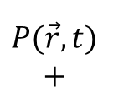
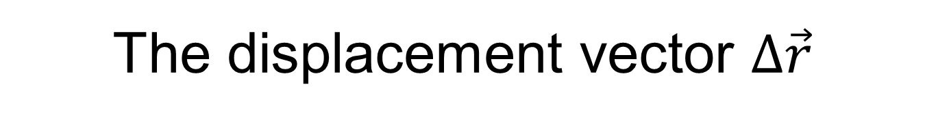

The displacement vector $∆\vec{r}$
$$y$$
$$P(\vec{r},t)$$
$$+$$
$$+$$
$$P(\vec{r}+∆\vec{r},t+∆t)$$
$$\vec{r}$$
$$\vec{r′}=\vec{r}+∆\vec{r}$$
$$O$$
$$x$$
$$z$$

Slide 34

The displacement vector $∆\vec{r}$
$$y$$
$$∆\vec{r}$$
$$P(\vec{r},t)$$
$$+$$
$$+$$
$$P(\vec{r}+∆\vec{r},t+∆t)$$
$$\vec{r}$$
$$\vec{r′}=\vec{r}+∆\vec{r}$$
$$O$$
$$x$$
$$z$$

Slide 35
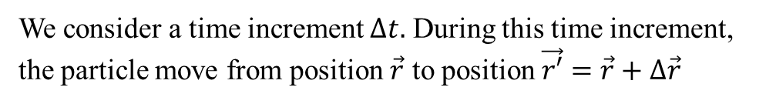
The displacement vector $∆\vec{r}$
$$y$$
$$∆\vec{r}$$
$$P(\vec{r},t)$$
$$+$$
$$+$$
$$P(\vec{r}+∆\vec{r},t+∆t)$$
$$\vec{r}$$
$$\vec{r′}=\vec{r}+∆\vec{r}$$
$$O$$
$$x$$
$$z$$
We consider a time increment $∆t.$ During this time increment, the particle move from position $\vec{r}$ to position $\vec{r′}=\vec{r}+∆\vec{r}$

Slide 36
The displacement vector $∆\vec{r}$
$$y$$
$$∆\vec{r}$$
$$P(\vec{r},t)$$
$$+$$
$$+$$
$$P(\vec{r}+∆\vec{r},t+∆t)$$
$$\vec{r}$$
$$\vec{r′}=\vec{r}+∆\vec{r}$$
$$O$$
$$x$$
$$z$$
We consider a time increment $∆t.$ During this time increment, the particle move from position $\vec{r}$ to position $\vec{r′}=\vec{r}+∆\vec{r}$

Slide 37


The displacement vector $∆\vec{r}$
$$y$$
$$∆\vec{r}$$
$$P(\vec{r},t)$$
$$+$$
$$+$$
$$P(\vec{r}+∆\vec{r},t+∆t)$$
$$\vec{r}$$
$$\vec{r′}=\vec{r}+∆\vec{r}$$
$$O$$
$$x$$
$$z$$
We consider a time increment $∆t.$ During this time increment, the particle move from position $\vec{r}$ to position $\vec{r′}=\vec{r}+∆\vec{r}$
The displacement vector $∆\vec{r}$ is such as:
$$∆\vec{r}={\vec{r}}^{′}−\vec{r}$$

Slide 38


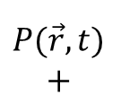


The infinitesimal displacement vector $d\vec{r}$
$$y$$
$$P(\vec{r},t)$$
$$+$$
$$+$$
$$P(\vec{r}+d\vec{r},t+dt)$$
$$\vec{r}$$
$$\vec{r′}=\vec{r}+d\vec{r}$$
$$O$$
$$x$$
$$z$$
We consider an infinitesimal increment of time $dt.$ During this time increment, the particle move from position $\vec{r}(t)$ to position $\vec{r}(t+dt)=\vec{r}+d\vec{r}$

Slide 39

The infinitesimal displacement vector $d\vec{r}$
$$y$$
$$d\vec{r}$$
$$P(\vec{r},t)$$
$$+$$
$$+$$
$$P(\vec{r}+d\vec{r},t+dt)$$
$$\vec{r}$$
$$\vec{r′}=\vec{r}+d\vec{r}$$
$$O$$
$$x$$
$$z$$
We consider an infinitesimal increment of time $dt.$ During this time increment, the particle move from position $\vec{r}(t)$ to position $\vec{r}(t+dt)=\vec{r}+d\vec{r}$

Slide 40


The infinitesimal displacement vector $d\vec{r}$
$$y$$
$$d\vec{r}$$
$$P(\vec{r},t)$$
$$+$$
$$+$$
$$P(\vec{r}+d\vec{r},t+dt)$$
$$\vec{r}$$
$$\vec{r′}=\vec{r}+d\vec{r}$$
$$O$$
$$x$$
$$z$$
We consider an infinitesimal increment of time $dt.$ During this time increment, the particle move from position $\vec{r}(t)$ to position $\vec{r}(t+dt)=\vec{r}+d\vec{r}$
The infinitesimal displacement vector $d\vec{r}$ is such as:
$$d\vec{r}=\vec{r}(t+dt)−\vec{r}(t)$$

Slide 41


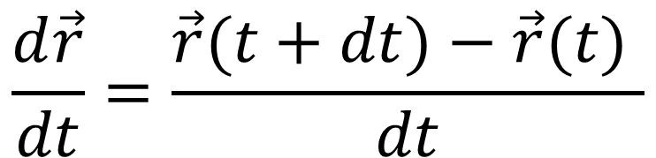
The velocity vector $\vec{v}$
$$d\vec{r}=\vec{r}(t+dt)−\vec{r}(t)$$
$$\frac{d\vec{r}}{dt}=\frac{\vec{r}(t+dt)−\vec{r}(t) }{dt}$$

Slide 42

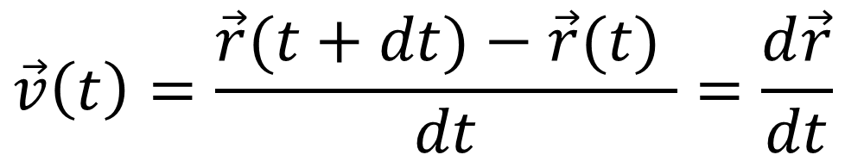
The velocity vector $\vec{v}$
$$d\vec{r}=\vec{r}(t+dt)−\vec{r}(t)$$
$$\frac{d\vec{r}}{dt}=\frac{\vec{r}(t+dt)−\vec{r}(t) }{dt}$$
Velocity vector $\vec{v}$:
$$\vec{v}\left(t\right)=\frac{\vec{r}(t+dt)−\vec{r}(t) }{dt}=\frac{d\vec{r}}{dt}$$
Important to remember

Slide 43
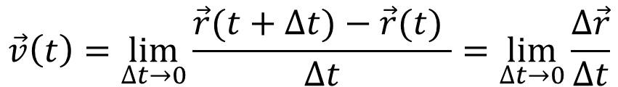
The velocity vector $\vec{v}$
$$d\vec{r}=\vec{r}(t+dt)−\vec{r}(t)$$
$$\frac{d\vec{r}}{dt}=\frac{\vec{r}(t+dt)−\vec{r}(t) }{dt}$$
Velocity vector $\vec{v}$:
$$\vec{v}\left(t\right)=\frac{\vec{r}(t+dt)−\vec{r}(t) }{dt}=\frac{d\vec{r}}{dt}$$
Important to remember
Another definition of the velocity vector, equivalent with the previous one is:
$$\vec{v}\left(t\right)=\lim_{∆t→0}{\frac{\vec{r}(t+∆t)−\vec{r}(t) }{∆t}=\lim_{∆t→0}{\frac{∆\vec{r}}{∆t}}}$$

Slide 44
Fin university physics lesson 1
Next slides: university physics lesson 2

Slide 45
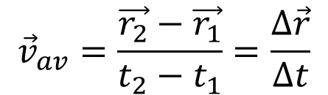
Average velocity vector between two positions of the particle
Warning
$${\vec{v}}_{av}=\frac{\vec{r_{2}}−\vec{r_{1}}}{t_{2}−t_{1}}=\frac{∆\vec{r}}{∆t}$$
Average velocity between two positions of the particle

Slide 46
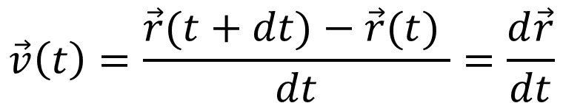
Average velocity vector between two positions of the particle
Warning
$${\vec{v}}_{av}=\frac{\vec{r_{2}}−\vec{r_{1}}}{t_{2}−t_{1}}=\frac{∆\vec{r}}{∆t}$$
Average velocity between two positions of the particle
$$\vec{v}\left(t\right)=\frac{\vec{r}(t+dt)−\vec{r}(t) }{dt}=\frac{d\vec{r}}{dt}$$

Slide 47
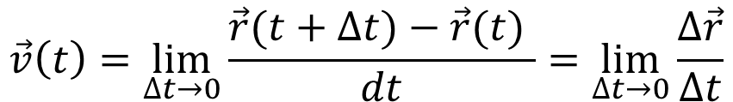
Average velocity vector between two positions of the particle
Warning
$${\vec{v}}_{av}=\frac{\vec{r_{2}}−\vec{r_{1}}}{t_{2}−t_{1}}=\frac{∆\vec{r}}{∆t}$$
Average velocity between two positions of the particle
$$\vec{v}\left(t\right)=\frac{\vec{r}(t+dt)−\vec{r}(t) }{dt}=\frac{d\vec{r}}{dt}$$
$$\vec{v}\left(t\right)=\lim_{∆t→0}{\frac{\vec{r}(t+∆t)−\vec{r}(t) }{dt}=\lim_{∆t→0}{\frac{∆\vec{r}}{∆t}}}$$

Slide 48
Average velocity vector between two positions of the particle
Warning
$${\vec{v}}_{av}=\frac{\vec{r_{2}}−\vec{r_{1}}}{t_{2}−t_{1}}=\frac{∆\vec{r}}{∆t}$$
Average velocity between two positions of the particle
$$\vec{v}\left(t\right)=\frac{\vec{r}(t+dt)−\vec{r}(t) }{dt}=\frac{d\vec{r}}{dt}$$
Instantaneous velocity vector at time t
$$\vec{v}\left(t\right)=\lim_{∆t→0}{\frac{\vec{r}(t+∆t)−\vec{r}(t) }{dt}=\lim_{∆t→0}{\frac{∆\vec{r}}{∆t}}}$$

Slide 49

Average velocity vector between two positions of the particle
Warning
$${\vec{v}}_{av}=\frac{\vec{r_{2}}−\vec{r_{1}}}{t_{2}−t_{1}}=\frac{∆\vec{r}}{∆t}$$
Average velocity between two positions of the particle
$$\vec{v}\left(t\right)=\frac{\vec{r}(t+dt)−\vec{r}(t) }{dt}=\frac{d\vec{r}}{dt}$$
Instantaneous velocity vector at time t
$$\vec{v}\left(t\right)=\lim_{∆t→0}{\frac{\vec{r}(t+∆t)−\vec{r}(t) }{dt}=\lim_{∆t→0}{\frac{∆\vec{r}}{∆t}}}$$
$$!$$
Take care to don’t confuse an average velocity and an instantaneous velocity

Slide 50

Average speed and average velocity
In Physics, average speed and average velocity don’t have exactly the same meaning.
Average speed is the total distance travelled (along the path) divided by the time interval:
$$!$$

Slide 51
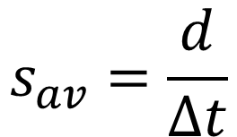
Average speed and average velocity
In Physics, average speed and average velocity don’t have exactly the same meaning.
Average speed is the total distance travelled (along the path) divided by the time interval:
$$s_{av}=\frac{d}{∆t}$$
distance travelled along the path
Average speed
$$!$$

Slide 52

Average speed and average velocity
In Physics, average speed and average velocity don’t have exactly the same meaning.
Average speed is the total distance travelled (along the path) divided by the time interval:
$$s_{av}=\frac{d}{∆t}$$
distance travelled along the path
$$d≠\left|∆r \right|$$
Average speed
$$!$$

Slide 53
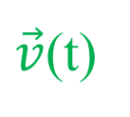







Velocity vector components
In Cartesian coordinates:
$$y$$
$$P$$
$$+$$
$$\vec{r}$$
$$\hat{t}$$
$\vec{v}$(t)
$$O$$
$$x$$
$$z$$

Slide 54
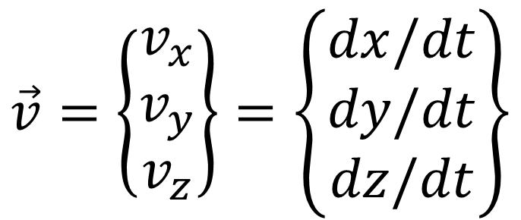
Velocity vector components
In Cartesian coordinates:
$$\vec{v}=\left\{\begin{matrix}v_{x} \\ v_{y} \\ v_{z}\end{matrix}\right\}=\left\{\begin{matrix}dx/dt \\ dy/dt \\ dz/dt\end{matrix}\right\}$$
$$y$$
$$P$$
$$+$$
$$\vec{r}$$
$$\hat{t}$$
$\vec{v}$(t)
$$O$$
$$x$$
$$z$$

Slide 55
Velocity vector components
In Cartesian coordinates:
$$\vec{v}=\left\{\begin{matrix}v_{x} \\ v_{y} \\ v_{z}\end{matrix}\right\}=\left\{\begin{matrix}dx/dt \\ dy/dt \\ dz/dt\end{matrix}\right\}$$
$$y$$
$$P$$
$$+$$
$$\vec{r}$$
$$\hat{t}$$
The velocity vector is tangent to the trajectory of the particle.
$\vec{v}$(t)
$$O$$
$$x$$
$$z$$

Slide 56

Velocity vector components
In Cartesian coordinates:
$$\vec{v}=\left\{\begin{matrix}v_{x} \\ v_{y} \\ v_{z}\end{matrix}\right\}=\left\{\begin{matrix}dx/dt \\ dy/dt \\ dz/dt\end{matrix}\right\}$$
$$y$$
$$P$$
$$+$$
$$\vec{r}$$
$$\hat{t}$$
The velocity vector is tangent to the trajectory of the particle.
$\vec{v}$(t)
$$O$$
$$x$$
$\hat{t}:$Tangent unit vector (unit vector tangent to the trajectory)
$$\vec{v}=v\hat{t}$$
$$z$$

Slide 57





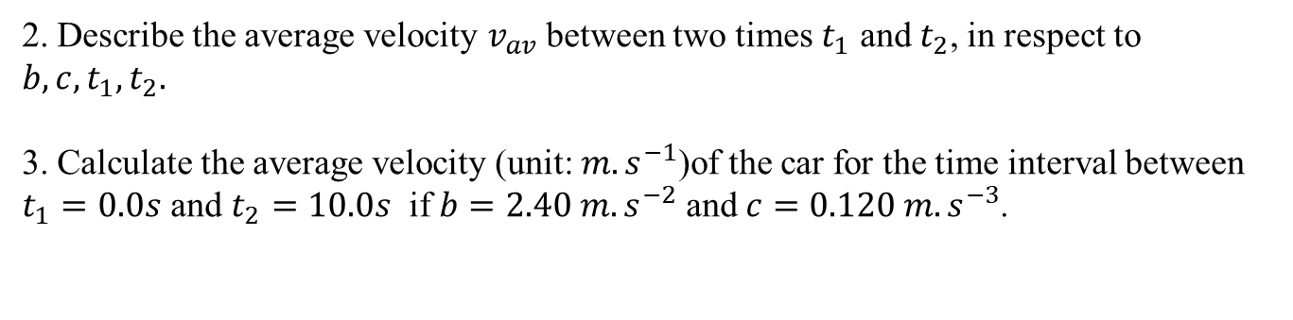
Ex. Velocity calculation
(5 minutes)
$$O$$
$$x$$
$$x=0$$
A car travels along a straight line (x-axis), moving toward the right or the toward left, and the x-coordinate in respect to the time of a point of the car is described by:
$$x\left(t\right)=bt^{2}−ct^{3}$$
where $b$ and $c$ are constants.
1. Describe $v_{x}(t)$ the instantaneous velocity of the car (x-component) at any time.
2. Describe the average velocity $v_{av}$ between two times $t_{1}$ and $t_{2}$, in respect to $b,c,t_{1},t_{2}.$
3. Calculate the average velocity (unit: $m.s^{−1}$)of the car for the time interval between $t_{1}=0.0s$ and $t_{2}=10.0s$ if $b=2.40 m.s^{−2}$ and $c=0.120 m.s^{−3}$.

Slide 58

Ex. Velocity calculation
$$O$$
$$x$$
$$x=0$$
A car travels along a straight line (x-axis), moving toward the right or the toward left, and the x-coordinate in respect to the time of a point of the car is described by:
$$x\left(t\right)=bt^{2}−ct^{3}$$
where $b$ and $c$ are constants.
1. Describe $v_{x}(t)$ the instantaneous velocity of the car (x-component) at any time.
$$x\left(t\right)=bt^{2}−ct^{3}$$

Slide 59

Ex. Velocity calculation
$$O$$
$$x$$
$$x=0$$
A car travels along a straight line (x-axis), moving toward the right or the toward left, and the x-coordinate in respect to the time of a point of the car is described by:
$$x\left(t\right)=bt^{2}−ct^{3}$$
where $b$ and $c$ are constants.
1. Describe $v_{x}(t)$ the instantaneous velocity of the car (x-component) at any time.
$$v_{x}\left(t\right)=\frac{dx}{dt}=2bt−3ct^{2}$$
$$x\left(t\right)=bt^{2}−ct^{3}$$

Slide 60
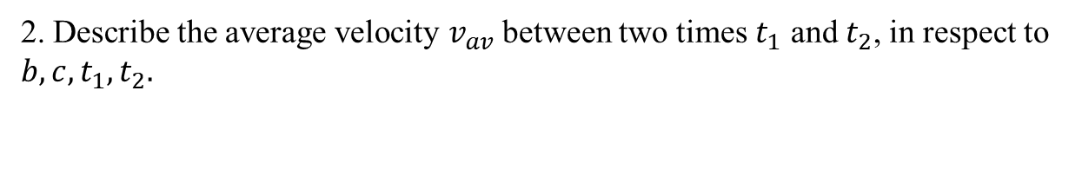
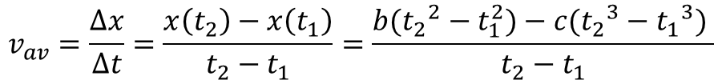
Ex. Velocity calculation
$$O$$
$$x$$
$$x=0$$
A car travels along a straight line (x-axis), moving toward the right or the toward left, and the x-coordinate in respect to the time of a point of the car is described by:
$$x\left(t\right)=bt^{2}−ct^{3}$$
where $b$ and $c$ are constants.
2. Describe the average velocity $v_{av}$ between two times $t_{1}$ and $t_{2}$, in respect to $b,c,t_{1},t_{2}.$
$$v_{av}=\frac{∆x}{∆t}=\frac{x\left(t_{2}\right)−x\left(t_{1}\right)}{t_{2}−t_{1}}=\frac{b({t_{2}}^{2}−t_{1}^{2})−c({t_{2}}^{3}−{t_{1}}^{3}) }{t_{2}−t_{1}}$$

Slide 61
Ex. Velocity calculation
$$O$$
$$x$$
$$x=0$$
A car travels along a straight line (x-axis), moving toward the right or the toward left, and the x-coordinate in respect to the time of a point of the car is described by:
$$x\left(t\right)=bt^{2}−ct^{3}$$
where $b$ and $c$ are constants.
2. Describe the average velocity $v_{av}$ between two times $t_{1}$ and $t_{2}$, in respect to $b,c,t_{1},t_{2}.$
$$v_{av}=\frac{∆x}{∆t}=\frac{x\left(t_{2}\right)−x\left(t_{1}\right)}{t_{2}−t_{1}}=\frac{b({t_{2}}^{2}−t_{1}^{2})−c({t_{2}}^{3}−{t_{1}}^{3}) }{t_{2}−t_{1}}$$
3. Calculate the average velocity (unit: $m.s^{−1}$)of the car for the time interval between $t_{1}=0.0s$ and $t_{2}=10.0s$ if $b=2.40 m.s^{−2}$ and $c=0.120 m.s^{−3}$.
$$v_{av}=\frac{(2.40 m.s^{−2})({10.0}^{2} s^{2})−(0.120 m.s^{−3}) ({10.0}^{3} s^{3}) }{10.0 s}$$

Slide 62
Ex. Velocity calculation
3. Calculate the average velocity (unit: $m.s^{−1}$)of the car for the time interval between $t_{1}=0.0s$ and $t_{2}=10.0s$ if $b=2.40 m.s^{−2}$ and $c=0.120 m.s^{−3}$.
$$v_{av}=\frac{(2.40 m.s^{−2})({10.0}^{2} s^{2})−(0.120 m.s^{−3}) ({10.0}^{3} s^{3}) }{10.0 s}$$

Slide 63
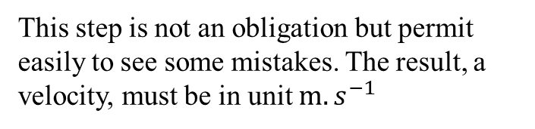
Ex. Velocity calculation
3. Calculate the average velocity (unit: $m.s^{−1}$)of the car for the time interval between $t_{1}=0.0s$ and $t_{2}=10.0s$ if $b=2.40 m.s^{−2}$ and $c=0.120 m.s^{−3}$.
$$v_{av}=\frac{(2.40 m.s^{−2})({10.0}^{2} s^{2})−(0.120 m.s^{−3}) ({10.0}^{3} s^{3}) }{10.0 s}$$
This step is not an obligation but permit easily to see some mistakes. The result, a velocity, must be in unit $m.s^{−1}$

Slide 64

Ex. Velocity calculation
3. Calculate the average velocity (unit: $m.s^{−1}$)of the car for the time interval between $t_{1}=0.0s$ and $t_{2}=10.0s$ if $b=2.40 m.s^{−2}$ and $c=0.120 m.s^{−3}$.
$$v_{av}=\frac{(2.40 m.s^{−2})({10.0}^{2} s^{2})−(0.120 m.s^{−3}) ({10.0}^{3} s^{3}) }{10.0 s}$$
This step is not an obligation but permit easily to see some mistakes. The result, a velocity, must be in unit $m.s^{−1}$
$$v_{av}=\frac{120 m}{10.0 s}=12.0 m.s^{−1}$$

Slide 65











Average speed and average velocity
In Physics, average speed and average velocity don’t have exactly the same meaning.
$$y$$
$$∆\vec{r}$$
$$P(\vec{r_{1}},t_{1})$$
$$+$$
$$+$$
$$P(\vec{r_{2}},t_{2})$$
$$\vec{r_{1}}$$
$$\vec{r_{2}}$$
$$O$$
$$x$$
Distance travelled along the path d
$$d≠\left|∆r \right|$$
$$z$$

Slide 66



Coordinate along the trajectory $s$ and displacement along the trajectory $∆s$
$$+P$$
$$+O$$
Trajectory of the particle (point P)
Some times, it could be convenient to use $s=\hat{OP}$ to describe the motion.

Slide 67






Coordinate along the trajectory $s$ and displacement along the trajectory $∆s$
$$+P$$
$$+O$$
Trajectory of the particle (point P)
Some times, it could be convenient to use $s=\hat{OP}$ to describe the motion.
Trajectory of the particle (point P)
$$s$$
$$!$$
$$+P$$
$$s≠\overline{OP}$$
$$+O$$
$$\overline{OP}$$

Slide 68
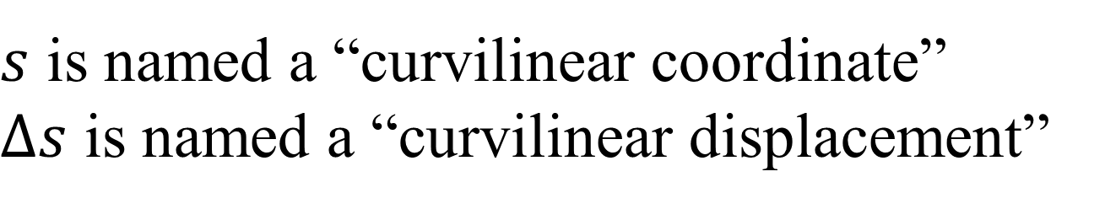


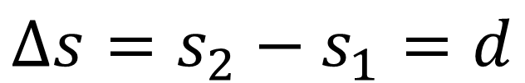


Coordinate along the trajectory $s$ and displacement along the trajectory $∆s$
$$∆s$$
$$+ s_{1}=s(t)$$
$$+$$
$$s_{2}=s(t+∆t)$$
Trajectory of the particle (point P)
$$+O$$
$$∆s=s_{2}−s_{1}=d$$
$s$ is named a “curvilinear coordinate”
$∆s$ is named a “curvilinear displacement”

Slide 69
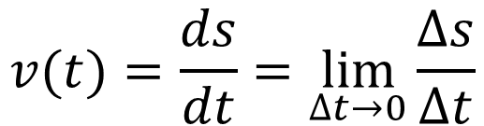

Coordinate along the trajectory $s$ and displacement along the trajectory $∆s$
$$\vec{v}$$
$$+P$$
Trajectory of the particle (point P)
$$+O$$
The velocity can also be defined as follows:
$$v(t)=\frac{ds}{dt}=\lim_{∆t→0}{\frac{∆s}{∆t}}$$

Slide 70
Coordinate along the trajectory $s$ and displacement along the trajectory $∆s$
$$\vec{v}$$
$$+P$$
Trajectory of the particle (point P)
$$+O$$
The velocity can also be defined as follows:
$$v(t)=\frac{ds}{dt}=\lim_{∆t→0}{\frac{∆s}{∆t}}$$
The velocity vector of the particle is always tangent to the trajectory of the particle

Slide 71
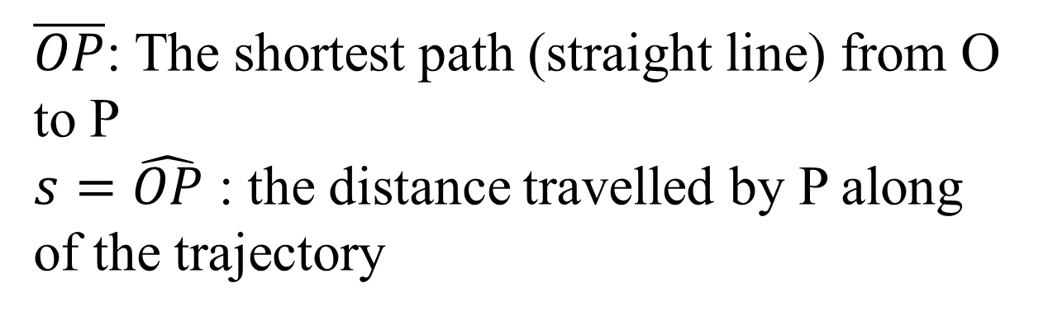





The curvilinear coordinate $s$
$$s$$
$$+P$$
$$+O$$
$$\overline{OP}$$
Trajectory of the particle (point P
$\overline{OP}$: The shortest path (straight line) from O to P
$s=\hat{OP}$ : the distance travelled by P along of the trajectory

Slide 72
The curvilinear coordinate $s$
$$s$$
$$+P$$
$$+O$$
$$\overline{OP}$$
Trajectory of the particle (point P
$\overline{OP}$: The shortest path (straight line) from O to P
$s=\hat{OP}$ : the distance travelled by P along of the trajectory
The trajectory can have any shape: straight line, curve, circular …

Slide 73

We want to study the motion of the point P
$$\vec{r}=x\hat{i}+y\hat{j}+z\hat{k}$$
$$\vec{r}\left(t\right)=x(t)\hat{i} +y(t)\hat{j} +z(t)\hat{k}$$
However, when we study a particle in motion, it is implicit that the coordinates of the particle vary with time, so we can omit “(t)”…

Slide 74









The velocity vector
$$\vec{v}(x,y,z,t)$$
$$y$$
$$+P(x,y,z,t)$$
$$\hat{j}$$
$$O$$
$$x$$
$$\hat{i}$$
$$\hat{k}$$
$$\vec{r}\left(t\right)=x(t)\hat{i} +y(t)\hat{j} +z(t)\hat{k}$$
$$k$$

Slide 75
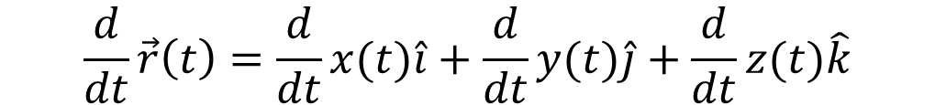
The velocity vector
$$\vec{v}(x,y,z,t)$$
$$y$$
$$+P(x,y,z,t)$$
$$\hat{j}$$
$$O$$
$$x$$
$$\hat{i}$$
$$\hat{k}$$
$$\vec{r}\left(t\right)=x(t)\hat{i} +y(t)\hat{j} +z(t)\hat{k}$$
$$k$$
$$\frac{d}{dt}\vec{r}\left(t\right)=\frac{d}{dt}x(t)\hat{i}+\frac{d}{dt}y(t)\hat{j}+\frac{d}{dt}z(t)\hat{k}$$

Slide 76
The velocity vector
$$\vec{v}(x,y,z,t)$$
$$y$$
$$+P(x,y,z,t)$$
$$\hat{j}$$
$$O$$
$$x$$
$$\hat{i}$$
$$\hat{k}$$
$$\vec{r}\left(t\right)=x(t)\hat{i} +y(t)\hat{j} +z(t)\hat{k}$$
$$k$$
$$\frac{d}{dt}\vec{r}\left(t\right)=\frac{d}{dt}x(t)\hat{i}+\frac{d}{dt}y(t)\hat{j}+\frac{d}{dt}z(t)\hat{k}$$
$$\vec{v}\left(t\right)=v_{x}(t)\hat{i}+v_{y}(t)\hat{j}+v_{z}(t)\hat{k}$$

Slide 77
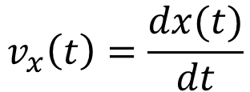
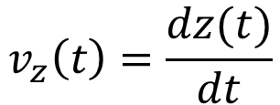
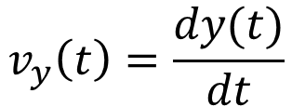
The velocity vector components in Cartesian coordinate system
$$\vec{v}\left(t\right)=v_{x}(t)\hat{i}+v_{y}(t)\hat{j}+v_{z}(t)\hat{k}$$
where
$$v_{x}\left(t\right)=\frac{dx(t)}{dt}$$
$$v_{y}\left(t\right)=\frac{dy(t)}{dt}$$
$$v_{z}\left(t\right)=\frac{dz(t)}{dt}$$

Slide 78





The velocity vector components in Cartesian coordinate system
$$\vec{v}\left(t\right)=v_{x}(t)\hat{i}+v_{y}(t)\hat{j}+v_{z}(t)\hat{k}$$
where
$$v_{x}\left(t\right)=\frac{dx(t)}{dt}$$
$$v_{y}\left(t\right)=\frac{dy(t)}{dt}$$
$$v_{z}\left(t\right)=\frac{dz(t)}{dt}$$
$$\vec{v}(t)$$
The velocity vector is tangent to the trajectory of the particle.
$$y$$
$$+P$$
$$O$$
$$x$$

Slide 79
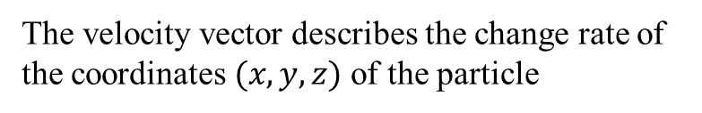
The velocity vector components in Cartesian coordinate system
$$\vec{v}\left(t\right)=v_{x}(t)\hat{i}+v_{y}(t)\hat{j}+v_{z}(t)\hat{k}$$
where
$$v_{x}\left(t\right)=\frac{dx(t)}{dt}$$
$$v_{y}\left(t\right)=\frac{dy(t)}{dt}$$
$$v_{z}\left(t\right)=\frac{dz(t)}{dt}$$
$$\vec{v}(t)$$
The velocity vector is tangent to the trajectory of the particle.
$$y$$
$$+P$$
$$O$$
$$x$$
The velocity vector describes the change rate of the coordinates $(x,y,z)$of the particle

Slide 80
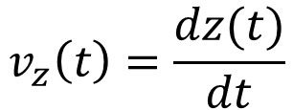
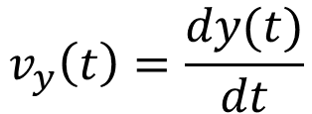
The velocity vector
$$\vec{v}\left(t\right)=v_{x}(t)\hat{i}+v_{y}(t)\hat{j}+v_{z}(t)\hat{k}$$
where
$$v_{y}\left(t\right)=\frac{dy(t)}{dt}$$
$$v_{z}\left(t\right)=\frac{dz(t)}{dt}$$
$$v_{x}\left(t\right)=\frac{dx(t)}{dt}$$

Slide 81
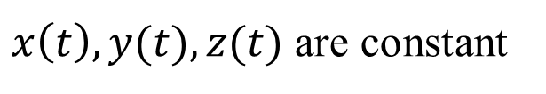
The velocity vector
$$\vec{v}\left(t\right)=v_{x}(t)\hat{i}+v_{y}(t)\hat{j}+v_{z}(t)\hat{k}$$
where
$$v_{y}\left(t\right)=\frac{dy(t)}{dt}$$
$$v_{z}\left(t\right)=\frac{dz(t)}{dt}$$
$$v_{x}\left(t\right)=\frac{dx(t)}{dt}$$
Particular case: particle at rest
$x\left(t\right),y(t),z(t)$ are constant

Slide 82



The velocity vector
$$\vec{v}\left(t\right)=v_{x}(t)\hat{i}+v_{y}(t)\hat{j}+v_{z}(t)\hat{k}$$
where
$$v_{y}\left(t\right)=\frac{dy(t)}{dt}$$
$$v_{z}\left(t\right)=\frac{dz(t)}{dt}$$
$$v_{x}\left(t\right)=\frac{dx(t)}{dt}$$
Particular case: particle at rest
$$v_{x}\left(t\right)=0$$
$x\left(t\right),y(t),z(t)$ are constant
$$v_{y}\left(t\right)=0$$
$$v_{x}\left(t\right)=0$$

Slide 83
The velocity vector
$$\vec{v}\left(t\right)=v_{x}(t)\hat{i}+v_{y}(t)\hat{j}+v_{z}(t)\hat{k}$$
where
$$v_{y}\left(t\right)=\frac{dy(t)}{dt}$$
$$v_{z}\left(t\right)=\frac{dz(t)}{dt}$$
$$v_{x}\left(t\right)=\frac{dx(t)}{dt}$$
Particular case: particle at rest
$$v_{x}\left(t\right)=0$$
$x\left(t\right),y(t),z(t)$ are constant
$$v_{y}\left(t\right)=0$$
$$v_{x}\left(t\right)=0$$
Excepted for this situation, it is implicit that the particle move, (displacement, its position change with time) so we can simply use:
$$\vec{v}=v_{x}\hat{i}+v_{y}\hat{j}+v_{z}\hat{k}$$

Slide 84
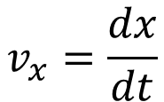
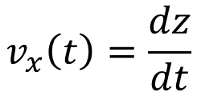
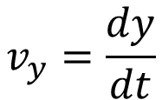
The velocity vector
$$\vec{v}\left(t\right)=v_{x}(t)\hat{i}+v_{y}(t)\hat{j}+v_{z}(t)\hat{k}$$
where
$$v_{y}\left(t\right)=\frac{dy(t)}{dt}$$
$$v_{z}\left(t\right)=\frac{dz(t)}{dt}$$
$$v_{x}\left(t\right)=\frac{dx(t)}{dt}$$
Particular case: particle at rest
$$v_{x}\left(t\right)=0$$
$x\left(t\right),y(t),z(t)$ are constant
$$v_{y}\left(t\right)=0$$
$$v_{x}\left(t\right)=0$$
Excepted for this situation, it is implicit that the particle move, (displacement, its position change with time) so we can simply use:
$$\vec{v}=v_{x}\hat{i}+v_{y}\hat{j}+v_{z}\hat{k}$$
$$v_{x}=\frac{dx}{dt}$$
$$v_{y}=\frac{dy}{dt}$$
$$v_{x}\left(t\right)=\frac{dz}{dt}$$

Slide 85
The acceleration vector
$$\vec{v}=v_{x}\hat{i}+v_{y}\hat{j}+v_{z}\hat{k}$$

Slide 86

The acceleration vector
$$\vec{v}=v_{x}\hat{i}+v_{y}\hat{j}+v_{z}\hat{k}$$
$$\frac{d}{dt}\vec{v}=\frac{d}{dt}v_{x}\hat{i}+\frac{d}{dt}v_{y}\hat{j}+\frac{d}{dt}v_{z}\hat{k}$$

Slide 87

The acceleration vector
$$\vec{v}=v_{x}\hat{i}+v_{y}\hat{j}+v_{z}\hat{k}$$
$$\frac{d}{dt}\vec{v}=\frac{d}{dt}v_{x}\hat{i}+\frac{d}{dt}v_{y}\hat{j}+\frac{d}{dt}v_{z}\hat{k}$$
acceleration vector
$$\vec{a}=a_{x}\hat{i}+a_{y}\hat{j}+a_{z}\hat{k}$$
Important to remember
where

Slide 88
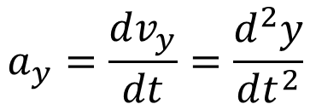
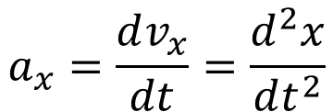
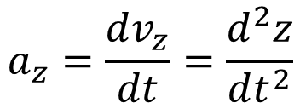
The acceleration vector
$$\vec{v}=v_{x}\hat{i}+v_{y}\hat{j}+v_{z}\hat{k}$$
$$\frac{d}{dt}\vec{v}=\frac{d}{dt}v_{x}\hat{i}+\frac{d}{dt}v_{y}\hat{j}+\frac{d}{dt}v_{z}\hat{k}$$
acceleration vector
$$\vec{a}=a_{x}\hat{i}+a_{y}\hat{j}+a_{z}\hat{k}$$
Important to remember
where
$$a_{x}=\frac{dv_{x}}{dt}=\frac{d^{2}x}{dt^{2}}$$
$$a_{y}=\frac{dv_{y}}{dt}=\frac{d^{2}y}{dt^{2}}$$
$$a_{z}=\frac{dv_{z}}{dt}=\frac{d^{2}z}{dt^{2}}$$

Slide 89
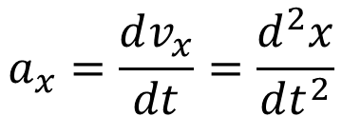
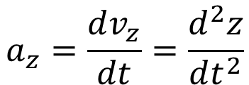
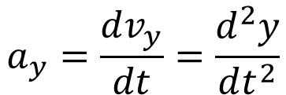
The acceleration vector
$$\vec{a}=a_{x}\hat{i}+a_{y}\hat{j}+a_{z}\hat{k}$$
acceleration vector
where
$$a_{x}=\frac{dv_{x}}{dt}=\frac{d^{2}x}{dt^{2}}$$
$$a_{y}=\frac{dv_{y}}{dt}=\frac{d^{2}y}{dt^{2}}$$
$$a_{z}=\frac{dv_{z}}{dt}=\frac{d^{2}z}{dt^{2}}$$

Slide 90
The acceleration vector
$$\vec{a}=a_{x}\hat{i}+a_{y}\hat{j}+a_{z}\hat{k}$$
acceleration vector
where
$$a_{x}=\frac{dv_{x}}{dt}=\frac{d^{2}x}{dt^{2}}$$
$$a_{y}=\frac{dv_{y}}{dt}=\frac{d^{2}y}{dt^{2}}$$
$$a_{z}=\frac{dv_{z}}{dt}=\frac{d^{2}z}{dt^{2}}$$
The acceleration vector describes the change rate of the velocity vector.

Slide 91

The acceleration vector
$$\vec{a}=a_{x}\hat{i}+a_{y}\hat{j}+a_{z}\hat{k}$$
acceleration vector
where
$$a_{x}=\frac{dv_{x}}{dt}=\frac{d^{2}x}{dt^{2}}$$
$$a_{y}=\frac{dv_{y}}{dt}=\frac{d^{2}y}{dt^{2}}$$
$$a_{z}=\frac{dv_{z}}{dt}=\frac{d^{2}z}{dt^{2}}$$
The acceleration vector describes the change rate of the velocity vector.

Slide 92

The acceleration vector
$$\vec{a}=a_{x}\hat{i}+a_{y}\hat{j}+a_{z}\hat{k}$$
acceleration vector
where
$$a_{x}=\frac{dv_{x}}{dt}=\frac{d^{2}x}{dt^{2}}$$
$$a_{y}=\frac{dv_{y}}{dt}=\frac{d^{2}y}{dt^{2}}$$
$$a_{z}=\frac{dv_{z}}{dt}=\frac{d^{2}z}{dt^{2}}$$
The acceleration vector describes the change rate of the velocity vector.
Warning: the acceleration vector $\vec{a}$ is not always perpendicular to the trajectory !

Slide 93



The acceleration vector
$$a_{x}=\frac{dv_{x}}{dt}=\frac{d^{2}x}{dt^{2}}$$
$$a_{y}=\frac{dv_{y}}{dt}=\frac{d^{2}y}{dt^{2}}$$
$$a_{z}=\frac{dv_{z}}{dt}=\frac{d^{2}z}{dt^{2}}$$
Particular cases:

Slide 94

The acceleration vector
$$a_{x}=\frac{dv_{x}}{dt}=\frac{d^{2}x}{dt^{2}}$$
$$a_{y}=\frac{dv_{y}}{dt}=\frac{d^{2}y}{dt^{2}}$$
$$a_{z}=\frac{dv_{z}}{dt}=\frac{d^{2}z}{dt^{2}}$$
Particular cases:
$$\vec{a}=\vec{0}$$
If the particle is at rest,

Slide 95


The acceleration vector
$$a_{x}=\frac{dv_{x}}{dt}=\frac{d^{2}x}{dt^{2}}$$
$$a_{y}=\frac{dv_{y}}{dt}=\frac{d^{2}y}{dt^{2}}$$
$$a_{z}=\frac{dv_{z}}{dt}=\frac{d^{2}z}{dt^{2}}$$
Particular cases:
$$\vec{a}=\vec{0}$$
If the particle is at rest,
$$\frac{dv_{x}}{dt}=\frac{dv_{y}}{dt}=\frac{dv_{z}}{dt}=0$$
If the particle has a linear uniform motion (velocity vector $\vec{v}$ is constant),

Slide 96

The acceleration vector
$$a_{x}=\frac{dv_{x}}{dt}=\frac{d^{2}x}{dt^{2}}$$
$$a_{y}=\frac{dv_{y}}{dt}=\frac{d^{2}y}{dt^{2}}$$
$$a_{z}=\frac{dv_{z}}{dt}=\frac{d^{2}z}{dt^{2}}$$
Particular cases:
$$\vec{a}=\vec{0}$$
If the particle is at rest,
$$\frac{dv_{x}}{dt}=\frac{dv_{y}}{dt}=\frac{dv_{z}}{dt}=0$$
If the particle has a linear uniform motion (velocity vector $\vec{v}$ is constant),
$$\vec{a}=\vec{0}$$

Slide 97







Ex. A vehicle with constant acceleration
$$\vec{a}=constant$$
$$O$$
$$x$$
$$x=0$$
$$x_{0}$$
$x(t)$ ?
A car moves at constant acceleration in the +x-direction ($a_{x}=constant,a_{y}=0, a_{z}=0$). At time $t_{0}$, at position $x_{0}=5.5$m, velocity of the car is $v_{0,x}$.
Describe the x-component of the velocity vector $v_{x}$of the car in respect to the time t, $v_{0,x}$, $a_{x}$, and $t_{0}$.
Calculate the velocity at time $t=t_{0}+2.0 s$if $v_{0,x}=15 m.s^{−1}$ and $a_{x}=4.0$ $m.s^{−2}$.
Describe the position $x(t)$ of the car in respect to the time $t$, $v_{0,x}$, $a_{x}, x_{0}$ and $t_{0}$. Your result is maybe quite complicated … How to simplify it ?
(5 minutes)

Slide 98


Ex. A vehicle with constant acceleration
$$\vec{a}=constant$$
$$O$$
$$x$$
$$x=0$$
$$x_{0}$$
$x(t)$ ?
A car moves at constant acceleration in the +x-direction ($a_{x}=constant,a_{y}=0, a_{z}=0$). At time $t_{0}$, at position $x_{0}$, velocity of the car is $v_{0,x}$.
Describe the x-component of the velocity vector $v_{x}$of the car in respect to the time t, $v_{0,x}$, $a_{x}$, and $t_{0}$.
$$a_{x}=\frac{dv_{x}}{dt}$$

Slide 99


Ex. A vehicle with constant acceleration
$$\vec{a}=constant$$
$$O$$
$$x$$
$$x=0$$
$$x_{0}$$
$x(t)$ ?
A car moves at constant acceleration in the +x-direction ($a_{x}=constant,a_{y}=0, a_{z}=0$). At time $t_{0}$, at position $x_{0}$, velocity of the car is $v_{0,x}$.
Describe the x-component of the velocity vector $v_{x}$of the car in respect to the time t, $v_{0,x}$, $a_{x}$, and $t_{0}$.
$$\int_{v_{0,x}}^{v_{x}}{dv_{x}}=\int_{t_{0}}^{t}{a_{x}dt }$$
$$a_{x}=\frac{dv_{x}}{dt}$$
$$dv_{x}=a_{x}dt$$

Slide 100

Ex. A vehicle with constant acceleration
$$\vec{a}=constant$$
$$O$$
$$x$$
$$x=0$$
$$x_{0}$$
$x(t)$ ?
A car moves at constant acceleration in the +x-direction ($a_{x}=constant,a_{y}=0, a_{z}=0$). At time $t_{0}$, at position $x_{0}$, velocity of the car is $v_{0,x}$.
Describe the x-component of the velocity vector $v_{x}$of the car in respect to the time t, $v_{0,x}$, $a_{x}$, and $t_{0}$.
$$\int_{v_{0,x}}^{v_{x}}{dv_{x}}=\int_{t_{0}}^{t}{a_{x}dt }$$
$$a_{x}=\frac{dv_{x}}{dt}$$
$$dv_{x}=a_{x}dt$$
$$v_{x}−v_{0,x}=a_{x}\left(t−t_{0}\right)$$

Slide 101

Ex. A vehicle with constant acceleration
$$\vec{a}=constant$$
$$O$$
$$x$$
$$x=0$$
$$x_{0}$$
$x(t)$ ?
A car moves at constant acceleration in the +x-direction ($a_{x}=constant,a_{y}=0, a_{z}=0$). At time $t_{0}$, at position $x_{0}$, velocity of the car is $v_{0,x}$.
Describe the x-component of the velocity vector $v_{x}$of the car in respect to the time t, $v_{0,x}$, $a_{x}$, and $t_{0}$.
$$\int_{v_{0,x}}^{v_{x}}{dv_{x}}=\int_{t_{0}}^{t}{a_{x}dt }$$
$$a_{x}=\frac{dv_{x}}{dt}$$
$$dv_{x}=a_{x}dt$$
$$v_{x}−v_{0,x}=a_{x}\left(t−t_{0}\right)$$
$$v_{x}=v_{0,x}+a_{x}\left(t−t_{0}\right)$$

Slide 102


Ex. A vehicle with constant acceleration
$$\vec{a}=constant$$
$$O$$
$$x$$
$$x=0$$
$$x_{0}$$
$x(t)$ ?
A car moves at constant acceleration $a_{x}$ in the +x-direction ($a_{x}=constant,a_{y}=0, a_{z}=0$). At time $t_{0}=0.0 s$, at position $x_{0}$, velocity of the car is $v_{0,x}$.
Describe the x-component of the velocity vector $v_{x}$of the car in respect to the time t, $v_{0,x}$, $a_{x}$, and $t_{0}$.
Calculate the velocity at time $t=t_{0}+2.0 s$ if $v_{0,x}=15 m.s^{−1}$ and $a_{x}=4.0$ $m.s^{−2}$.
$$v_{x}=v_{0,x}+a_{x}\left(t−t_{0}\right)$$

Slide 103

Ex. A vehicle with constant acceleration
$$\vec{a}=constant$$
$$O$$
$$x$$
$$x=0$$
$$x_{0}$$
$x(t)$ ?
A car moves at constant acceleration $a_{x}$ in the +x-direction ($a_{x}=constant,a_{y}=0, a_{z}=0$). At time $t_{0}=0.0 s$, at position $x_{0}$, velocity of the car is $v_{0,x}$.
Describe the x-component of the velocity vector $v_{x}$of the car in respect to the time t, $v_{0,x}$, $a_{x}$, and $t_{0}$.
Calculate the velocity at time $t=t_{0}+2.0 s$ if $v_{0,x}=15 m.s^{−1}$ and $a_{x}=4.0$ $m.s^{−2}$.
$$v_{x}=v_{0,x}+a_{x}\left(t−t_{0}\right)$$
$$v_{x}=(15 m.s^{−1})+(4.0 m.s^{−2})\left(2.0 s\right)$$
$$v_{x}=23 m.s^{−1}$$

Slide 104


Ex. A vehicle with constant acceleration
$$\vec{a}=constant$$
$$O$$
$$x$$
$$x=0$$
$$x_{0}$$
$x(t)$ ?
A car moves at constant acceleration $a_{x}$ in the +x-direction ($a_{x}=constant,a_{y}=0, a_{z}=0$). A t time $t_{0}=0.0 s$, at position $x_{0}$, velocity of the car is $v_{0,x}$.
3.Describe the position $x(t)$ of the car in respect to the time t, $v_{0,x}$, $a_{x}, x_{0}$ and $t_{0}$.
$$v_{x}=v_{0,x}+a_{x}\left(t−t_{0}\right)=\frac{dx}{dt}$$

Slide 105

Ex. A vehicle with constant acceleration
$$\vec{a}=constant$$
$$O$$
$$x$$
$$x=0$$
$$x_{0}$$
$x(t)$ ?
A car moves at constant acceleration $a_{x}$ in the +x-direction ($a_{x}=constant,a_{y}=0, a_{z}=0$). A t time $t_{0}=0.0 s$, at position $x_{0}$, velocity of the car is $v_{0,x}$.
3.Describe the position $x(t)$ of the car in respect to the time t, $v_{0,x}$, $a_{x}, x_{0}$ and $t_{0}$.
$$v_{x}=v_{0,x}+a_{x}\left(t−t_{0}\right)=\frac{dx}{dt}$$
$$dx=\left[v_{0,x}+a_{x}\left(t−t_{0}\right)\right]dt$$

Slide 106

Ex. A vehicle with constant acceleration
$$\vec{a}=constant$$
$$O$$
$$x$$
$$x=0$$
$$x_{0}$$
$x(t)$ ?
A car moves at constant acceleration $a_{x}$ in the +x-direction ($a_{x}=constant,a_{y}=0, a_{z}=0$). A t time $t_{0}=0.0 s$, at position $x_{0}$, velocity of the car is $v_{0,x}$.
3.Describe the position $x(t)$ of the car in respect to the time t, $v_{0,x}$, $a_{x}, x_{0}$ and $t_{0}$.
$$v_{x}=v_{0,x}+a_{x}\left(t−t_{0}\right)=\frac{dx}{dt}$$
$$dx=\left[v_{0,x}+a_{x}\left(t−t_{0}\right)\right]dt$$
$$\int_{x_{0}}^{x}{dx}=\int_{t_{0}}^{t}{\left[v_{0,x}+a_{x}\left(t−t_{0}\right)\right]dt }$$

Slide 107

Ex. A vehicle with constant acceleration
$$\vec{a}=constant$$
$$O$$
$$x$$
$$x=0$$
$$x_{0}$$
$x(t)$ ?
A car moves at constant acceleration $a_{x}$ in the +x-direction ($a_{x}=constant,a_{y}=0, a_{z}=0$). A t time $t_{0}=0.0 s$, at position $x_{0}$, velocity of the car is $v_{0,x}$.
3.Describe the position $x(t)$ of the car in respect to the time t, $v_{0,x}$, $a_{x}, x_{0}$ and $t_{0}$.
$$v_{x}=v_{0,x}+a_{x}\left(t−t_{0}\right)=\frac{dx}{dt}$$
$$dx=\left[v_{0,x}+a_{x}\left(t−t_{0}\right)\right]dt$$
$$\int_{x_{0}}^{x}{dx}=\int_{t_{0}}^{t}{\left[v_{0,x}+a_{x}\left(t−t_{0}\right)\right]dt }$$
$$x−x_{0}=\int_{t_{0}}^{t}{v_{0,x}dt \text{+}\int_{t_{0}}^{t}{a_{x}tdt }}−\int_{t_{0}}^{t}{a_{x}t_{o}dt }$$

Slide 108

Ex. A vehicle with constant acceleration
$$\vec{a}=constant$$
$$O$$
$$x$$
$$x=0$$
$$x_{0}$$
$x(t)$ ?
A car moves at constant acceleration $a_{x}$ in the +x-direction ($a_{x}=constant,a_{y}=0, a_{z}=0$). A t time $t_{0}=0.0 s$, at position $x_{0}$, velocity of the car is $v_{0,x}$.
3.Describe the position $x(t)$ of the car in respect to the time t, $v_{0,x}$, $a_{x}, x_{0}$ and $t_{0}$.
$$v_{x}=v_{0,x}+a_{x}\left(t−t_{0}\right)=\frac{dx}{dt}$$
$$dx=\left[v_{0,x}+a_{x}\left(t−t_{0}\right)\right]dt$$
$$\int_{x_{0}}^{x}{dx}=\int_{t_{0}}^{t}{\left[v_{0,x}+a_{x}\left(t−t_{0}\right)\right]dt }$$
$$x−x_{0}=\int_{t_{0}}^{t}{v_{0,x}dt \text{+}\int_{t_{0}}^{t}{a_{x}tdt }}−\int_{t_{0}}^{t}{a_{x}t_{o}dt }$$
$$x−x_{0}=v_{0,x}\int_{t_{0}}^{t}{dt \text{+}a_{x}\int_{t_{0}}^{t}{tdt }}−a_{x}t_{o}\int_{t_{0}}^{t}{dt }$$

Slide 109


Ex. A vehicle with constant acceleration
$$\vec{a}=constant$$
$$O$$
$$x$$
$$x=0$$
$$x_{0}$$
$x(t)$ ?
A car moves at constant acceleration $a_{x}$ in the +x-direction ($a_{x}=constant,a_{y}=0, a_{z}=0$). A t time $t_{0}=0.0 s$, at position $x_{0}$, velocity of the car is $v_{0,x}$.
3.Describe the position $x(t)$ of the car in respect to the time t, $v_{0,x}$, $a_{x}, x_{0}$ and $t_{0}$.
$$x−x_{0}=v_{0,x}\int_{t_{0}}^{t}{dt \text{+}a_{x}\int_{t_{0}}^{t}{tdt }}−a_{x}t_{o}\int_{t_{0}}^{t}{dt }$$

Slide 110

Ex. A vehicle with constant acceleration
$$\vec{a}=constant$$
$$O$$
$$x$$
$$x=0$$
$$x_{0}$$
$x(t)$ ?
A car moves at constant acceleration $a_{x}$ in the +x-direction ($a_{x}=constant,a_{y}=0, a_{z}=0$). A t time $t_{0}=0.0 s$, at position $x_{0}$, velocity of the car is $v_{0,x}$.
3.Describe the position $x(t)$ of the car in respect to the time t, $v_{0,x}$, $a_{x}, x_{0}$ and $t_{0}$.
$$x−x_{0}=v_{0,x}\int_{t_{0}}^{t}{dt \text{+}a_{x}\int_{t_{0}}^{t}{tdt }}−a_{x}t_{o}\int_{t_{0}}^{t}{dt }$$
$$x−x_{0}=v_{0,x}\left(t−t_{0}\right)+a_{x}\left(\frac{t^{2}}{2}−\frac{{t_{0}}^{2}}{2}\right)−a_{x}t_{o}\left(t−t_{0}\right)$$

Slide 111

Ex. A vehicle with constant acceleration
$$\vec{a}=constant$$
$$O$$
$$x$$
$$x=0$$
$$x_{0}$$
$x(t)$ ?
A car moves at constant acceleration $a_{x}$ in the +x-direction ($a_{x}=constant,a_{y}=0, a_{z}=0$). A t time $t_{0}=0.0 s$, at position $x_{0}$, velocity of the car is $v_{0,x}$.
3.Describe the position $x(t)$ of the car in respect to the time t, $v_{0,x}$, $a_{x}, x_{0}$ and $t_{0}$.
$$x−x_{0}=v_{0,x}\int_{t_{0}}^{t}{dt \text{+}a_{x}\int_{t_{0}}^{t}{tdt }}−a_{x}t_{o}\int_{t_{0}}^{t}{dt }$$
$$x−x_{0}=v_{0,x}\left(t−t_{0}\right)+a_{x}\left(\frac{t^{2}}{2}−\frac{{t_{0}}^{2}}{2}\right)−a_{x}t_{o}\left(t−t_{0}\right)$$
$$x\left(t\right)=x_{0}+(v_{0,x}−a_{x}t_{0})\left(t−t_{0}\right)+a_{x}\left(\frac{t^{2}}{2}−\frac{{t_{0}}^{2}}{2}\right)$$

Slide 112





Ex. A vehicle with constant acceleration
$$\vec{a}=constant$$
$$O$$
$$x$$
$$x=0$$
$x=x_{0}$ at time $t_{0}$
$x(t)$ ?
$$x\left(t\right)=x_{0}+(v_{0,x}−a_{x}t_{0})\left(t−t_{0}\right)+a_{x}\left(\frac{t^{2}}{2}−\frac{{t_{0}}^{2}}{2}\right)$$
This expression is quite complicated. But the choice of the origin of time is arbitrary. Using $t_{0}=0$, we obtain:
$$x\left(t\right)=x_{0}+ v_{0,x}t+\frac{1}{2}a_{x}t^{2}$$

Slide 113



Ex. A vehicle with constant acceleration
$$\vec{a}=constant$$
$$O$$
$$x$$
$$x=0$$
$x=x_{0}$ at time $t_{0}$
$x(t)$ ?
$$x\left(t\right)=x_{0}+(v_{0,x}−a_{x}t_{0})\left(t−t_{0}\right)+a_{x}\left(\frac{t^{2}}{2}−\frac{{t_{0}}^{2}}{2}\right)$$
This expression is quite complicated. But the choice of the origin of time is arbitrary. Using $t_{0}=0$, we obtain:
$$x\left(t\right)=x_{0}+ v_{0,x}t+\frac{1}{2}a_{x}t^{2}$$
It should have been more simple to use $t_{0}=0$ from the beginning:
$$x\left(t\right)=x_{0}+v_{0,x}t+\frac{1}{2}a_{x}t^{2}$$
$$dv_{x}=a_{x}dt$$
$$v_{x}=v_{0,x}+a_{x}t$$

Slide 114
End of lesson 2.
(commencer lesson 3 si plus de 5 minutes avant la fin, i.e. s’il est plus tot que 10h00)

Slide 115
Normallement, end of lesson 2 (selon les slides de Jiajie, mais trop court je pense … Rajouter exos ? Poursuivre avec ppt lesson 3 ?)

Slide 116
Warning about homework
About cheating at your homework …
You are adults, not children, you work for yourself and to improve your skills and understanding, which come with practice .
Homework is also important for me, to see if something has not been well explained during the lecture, for instance.
A VOIR EN LESSON 4 PUISQUE JE DONNE HOMEWORK LE MEME JOUR QUE LA LESSON 3
To fail in an examination or homework after you have done your best is not a shame. Failing can happens to anybody. But cheating is a shame.

Slide 117
About the middle and final examination
You are only allowed to use a calculator without memory
Your calculator must be able to calculate powers, square root, trigonometric functions ...
Excepted few particular cases, you don’t have to remember fundamental Physics constants (they will be given in the examination paper)
You need to remember the equations needed to solve the problems (they will be not given on the examination paper).
A VOIR EN LESSON 4 EN MEME TEMPS QUE HOMEWORK ET LA TRICHE

Slide 118
End of the lesson 2

Slide 119







$$d_{1}$$
$$d_{2}$$
$$x$$
$$∆\vec{r}$$
$$x_{0}=0$$
$$x_{1}$$
$$x_{2}$$

